Slide 1
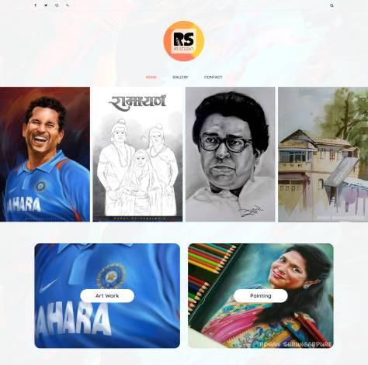



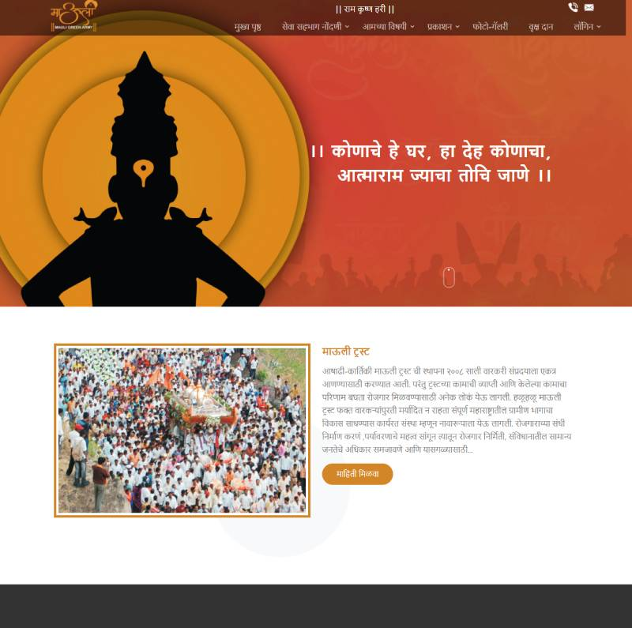
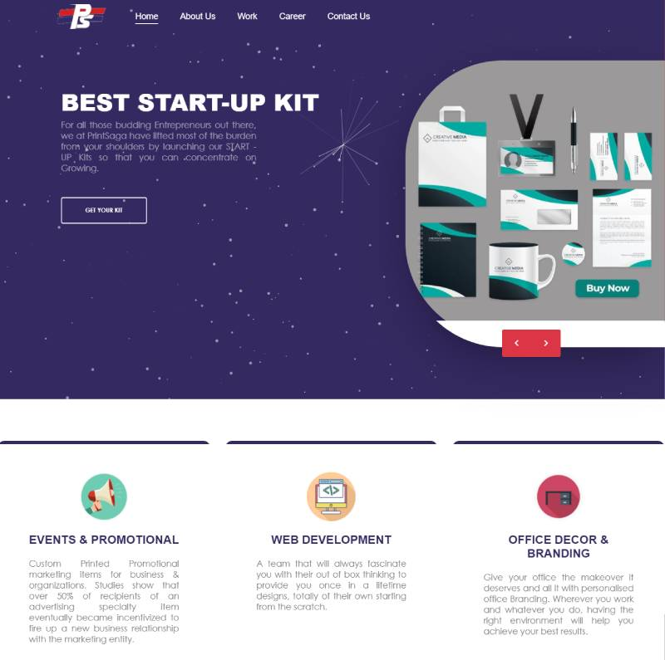


PORTFOLIO
Notes:
Links:
https://www.pexels.com/photo/blank-frame-above-table-205321/
https://www.pexels.com/photo/iphone-near-spiral-book-and-laptop-1036848/
https://www.pexels.com/photo/macbook-desk-iphone-technology-9411/
https://www.pexels.com/photo/background-creativity-decoration-design-587441/
https://www.pexels.com/photo/white-blank-notebook-733857/
https://www.pexels.com/photo/clipboard-and-newspaper-on-white-table-3944386/
https://www.pexels.com/photo/person-holding-clipboard-3944382/
https://www.pexels.com/photo/white-comforter-set-2387753/

Slide 2
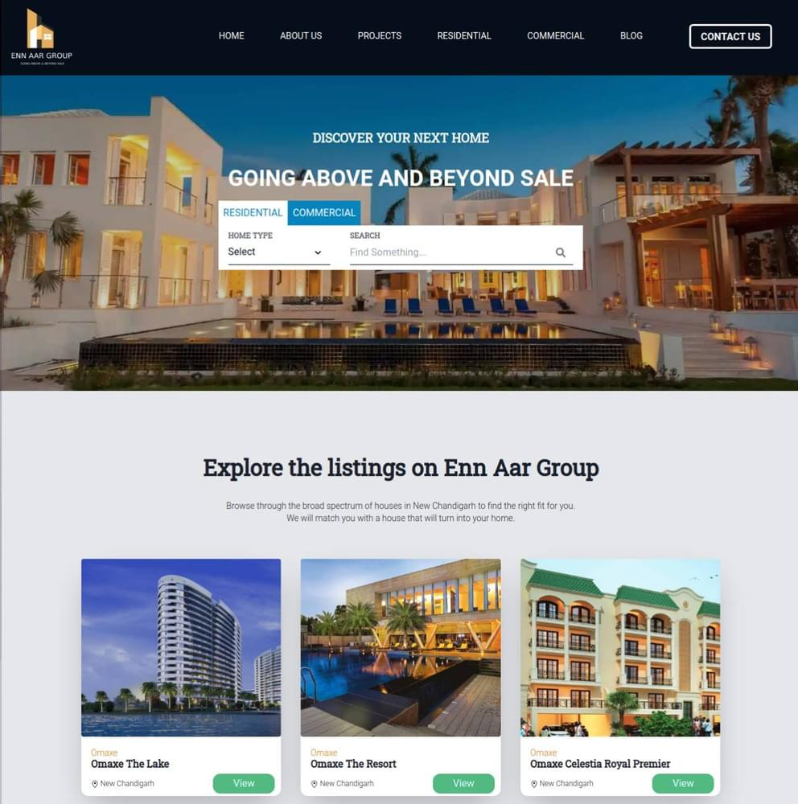






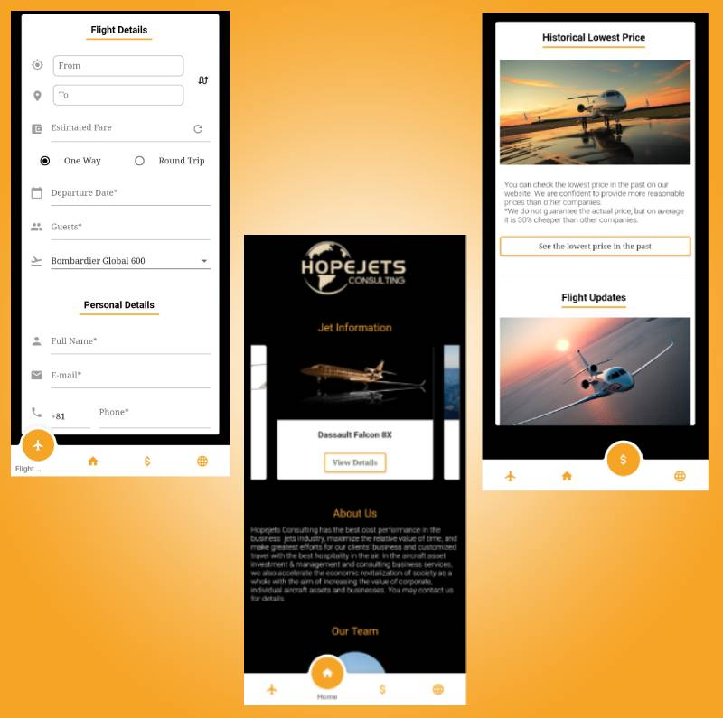
Notes:
Links:
https://www.pexels.com/photo/blank-frame-above-table-205321/
https://www.pexels.com/photo/iphone-near-spiral-book-and-laptop-1036848/
https://www.pexels.com/photo/macbook-desk-iphone-technology-9411/
https://www.pexels.com/photo/background-creativity-decoration-design-587441/
https://www.pexels.com/photo/white-blank-notebook-733857/
https://www.pexels.com/photo/clipboard-and-newspaper-on-white-table-3944386/

Slide 3
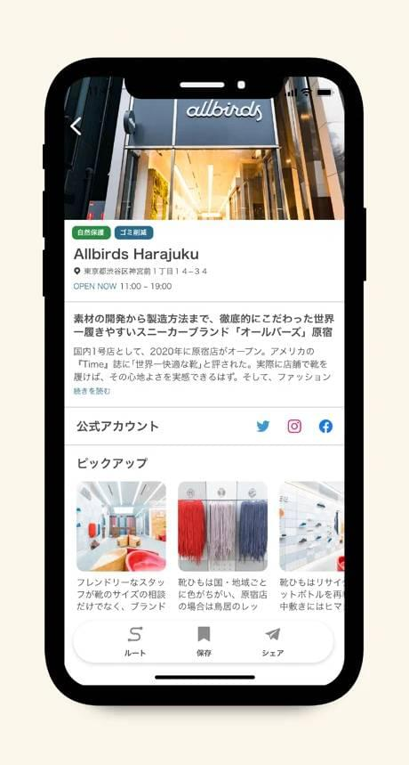


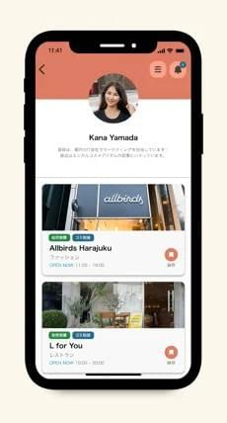

Notes:
Links:
https://www.pexels.com/photo/blank-frame-above-table-205321/
https://www.pexels.com/photo/iphone-near-spiral-book-and-laptop-1036848/
https://www.pexels.com/photo/macbook-desk-iphone-technology-9411/
https://www.pexels.com/photo/background-creativity-decoration-design-587441/
https://www.pexels.com/photo/white-blank-notebook-733857/
https://www.pexels.com/photo/clipboard-and-newspaper-on-white-table-3944386/

Slide 4
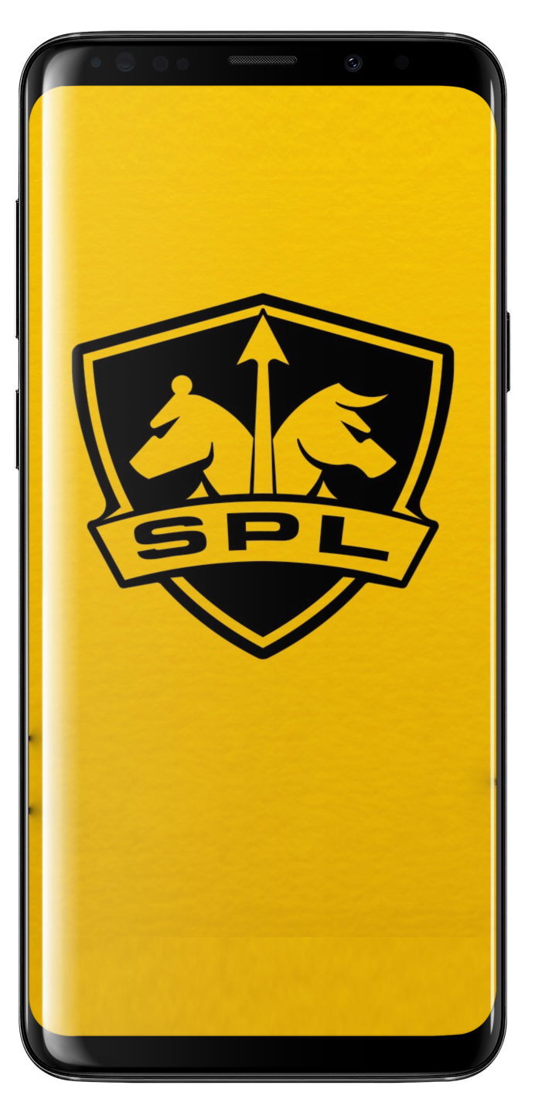
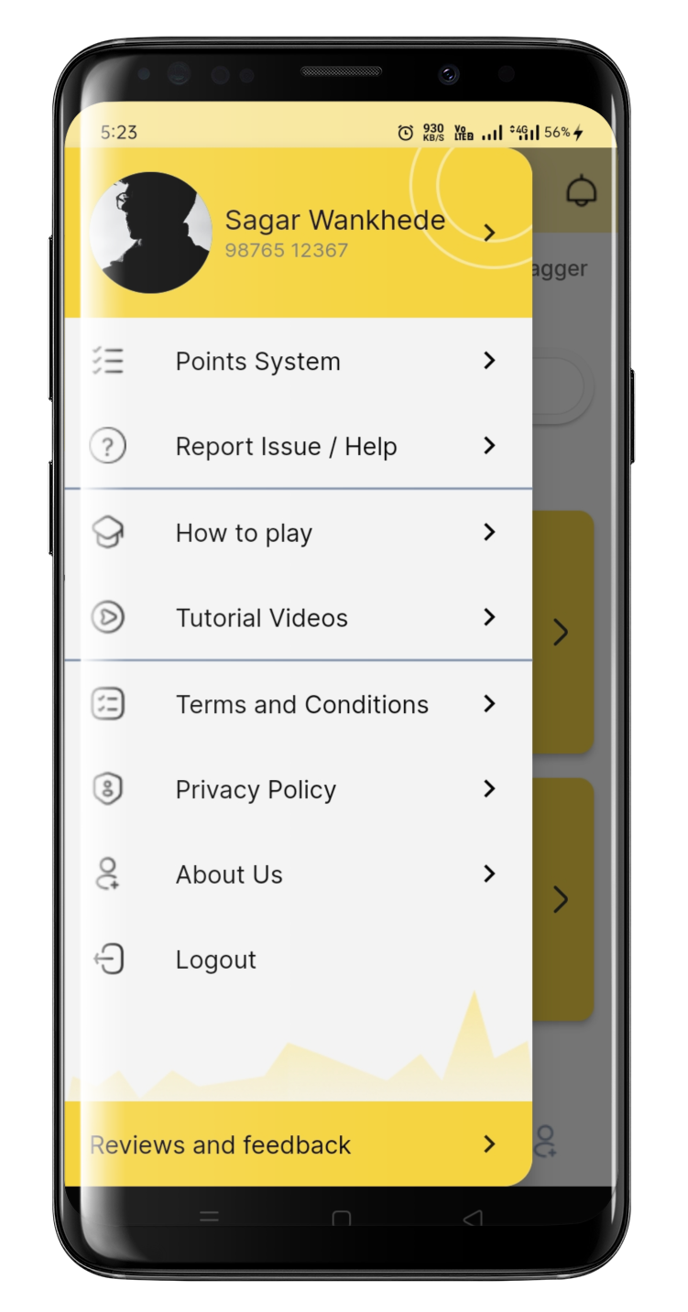
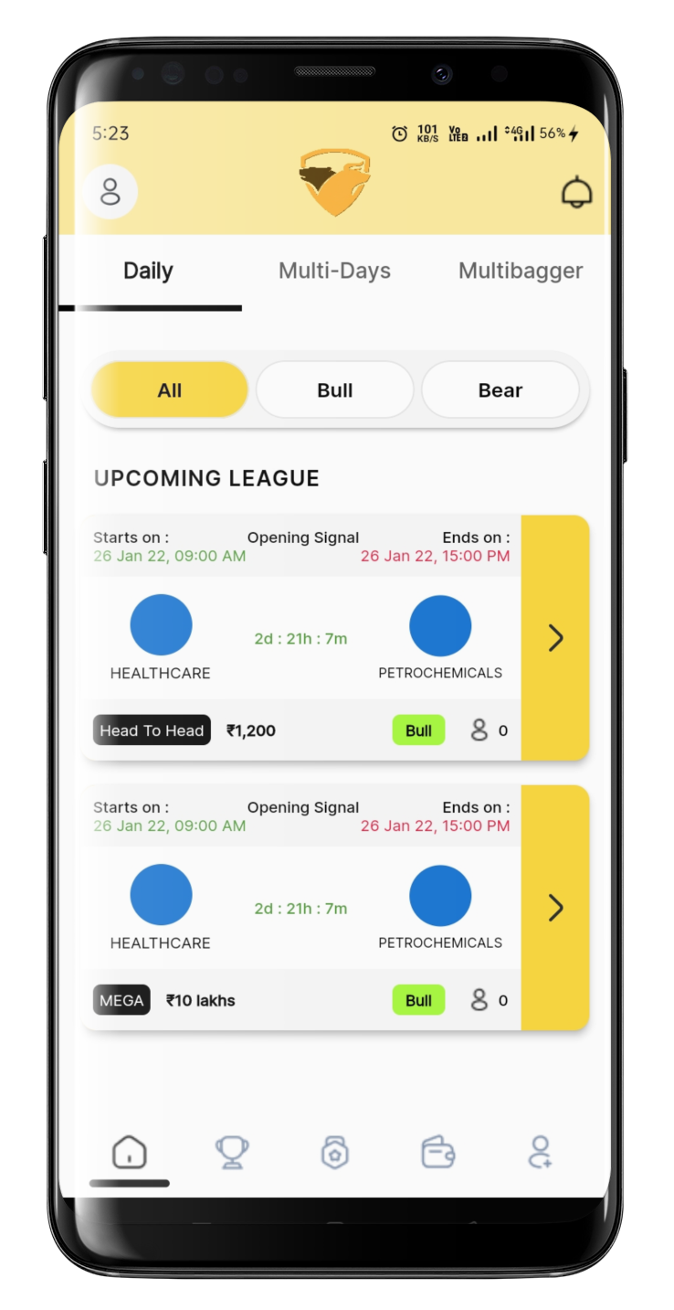
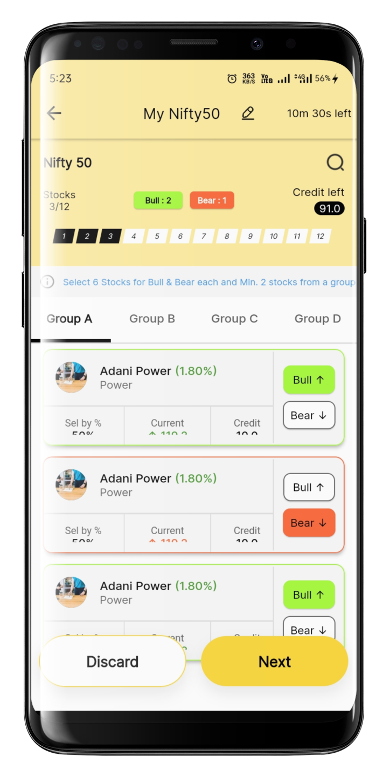
STOCK PREMIER LEAGUE
Notes:
Links:
https://www.pexels.com/photo/blank-frame-above-table-205321/
https://www.pexels.com/photo/iphone-near-spiral-book-and-laptop-1036848/
https://www.pexels.com/photo/macbook-desk-iphone-technology-9411/
https://www.pexels.com/photo/background-creativity-decoration-design-587441/
https://www.pexels.com/photo/white-blank-notebook-733857/
https://www.pexels.com/photo/clipboard-and-newspaper-on-white-table-3944386/

Slide 5

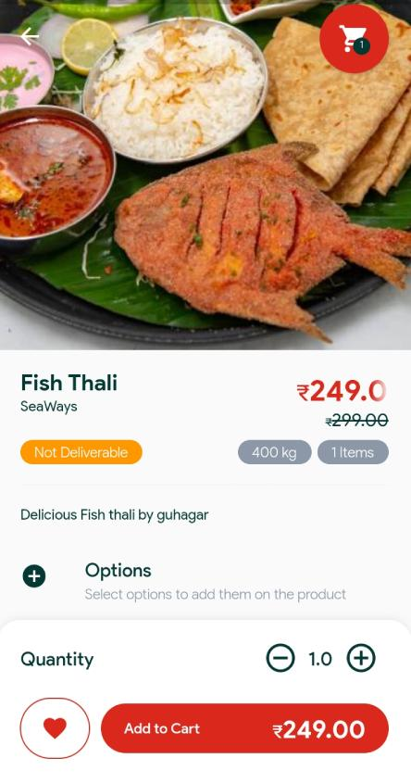
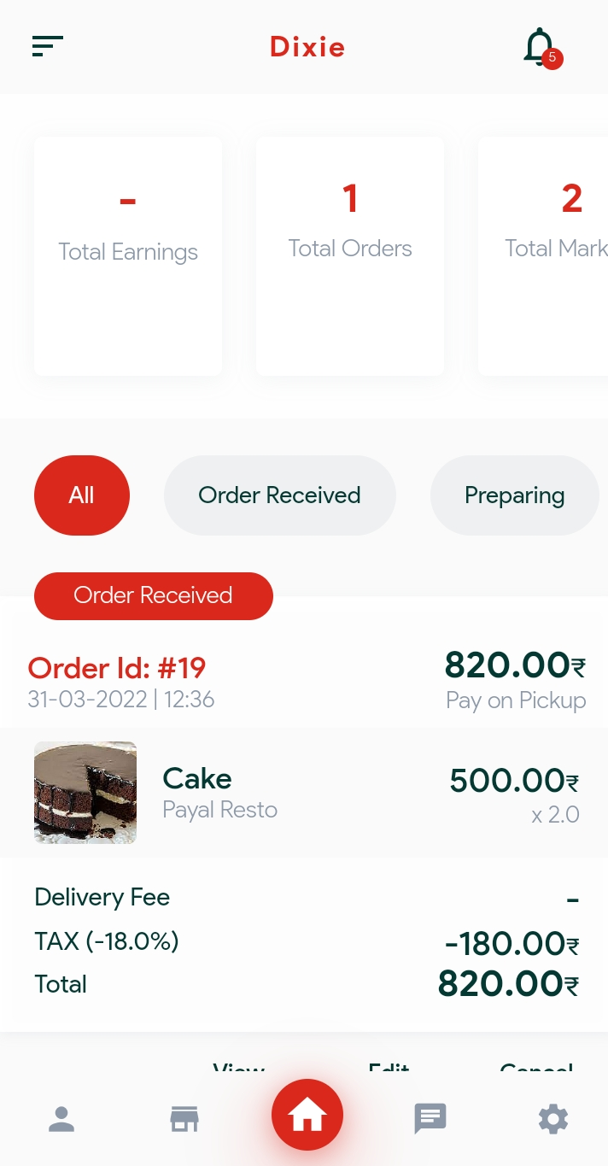
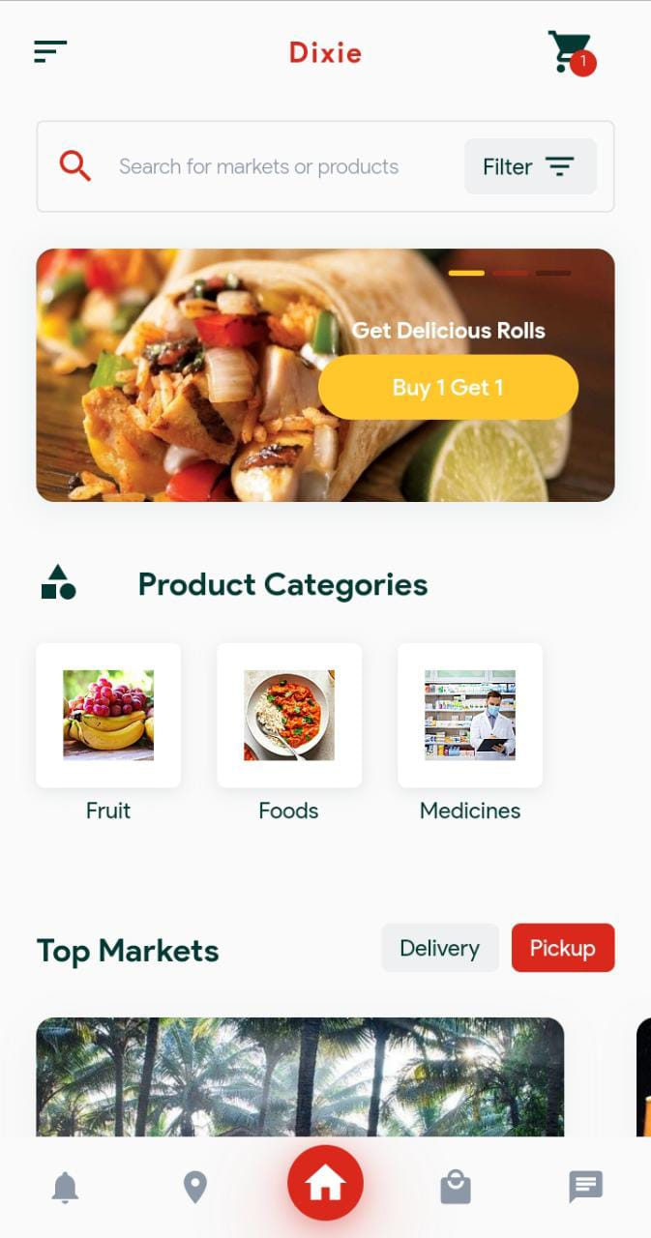
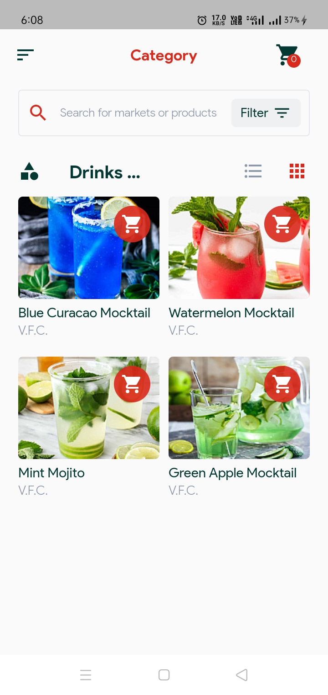
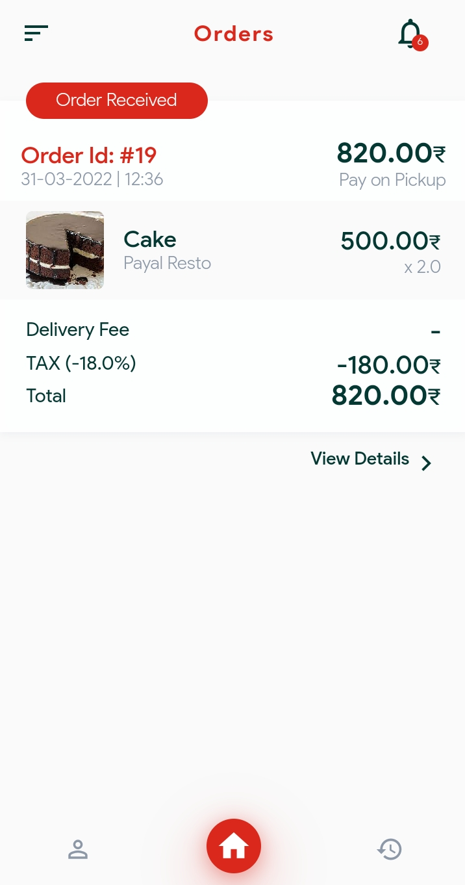
DIXIE DOOR DELIVERY
VENDOR APP
USER APP
DELIVERY PARTNER
Notes:
Links:
https://www.pexels.com/photo/blank-frame-above-table-205321/
https://www.pexels.com/photo/iphone-near-spiral-book-and-laptop-1036848/
https://www.pexels.com/photo/macbook-desk-iphone-technology-9411/
https://www.pexels.com/photo/background-creativity-decoration-design-587441/
https://www.pexels.com/photo/white-blank-notebook-733857/
https://www.pexels.com/photo/clipboard-and-newspaper-on-white-table-3944386/

Slide 6

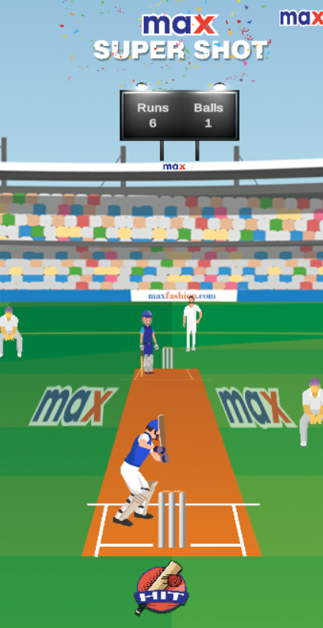
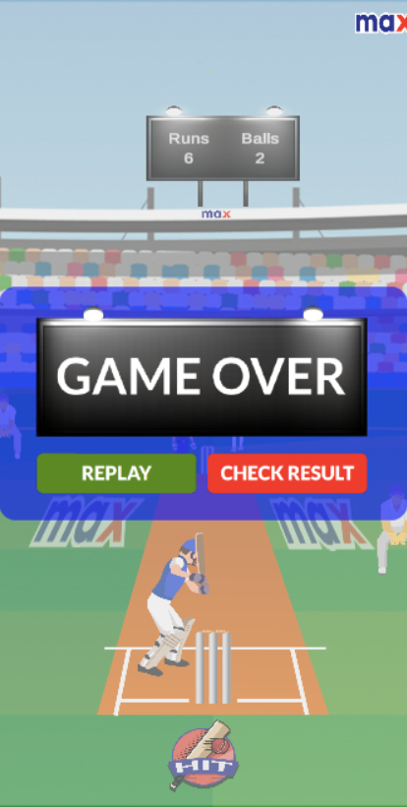

MAX IPL GAME
Notes:
Links:
https://www.pexels.com/photo/blank-frame-above-table-205321/
https://www.pexels.com/photo/iphone-near-spiral-book-and-laptop-1036848/
https://www.pexels.com/photo/macbook-desk-iphone-technology-9411/
https://www.pexels.com/photo/background-creativity-decoration-design-587441/
https://www.pexels.com/photo/white-blank-notebook-733857/
https://www.pexels.com/photo/clipboard-and-newspaper-on-white-table-3944386/

Slide 7


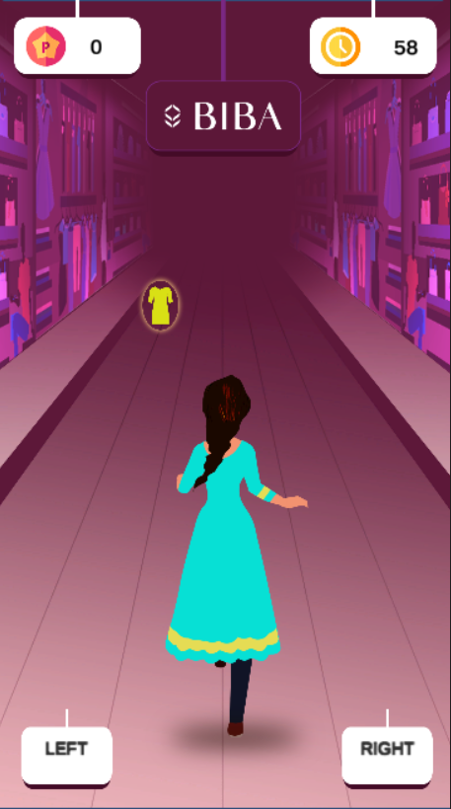
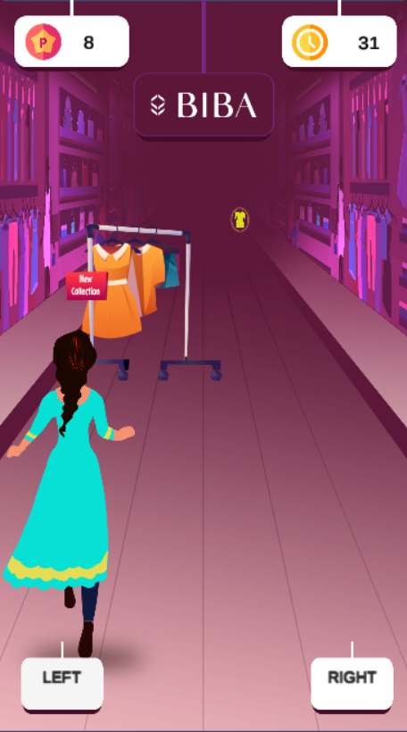
BIBA RUNNER GAME
Notes:
Links:
https://www.pexels.com/photo/blank-frame-above-table-205321/
https://www.pexels.com/photo/iphone-near-spiral-book-and-laptop-1036848/
https://www.pexels.com/photo/macbook-desk-iphone-technology-9411/
https://www.pexels.com/photo/background-creativity-decoration-design-587441/
https://www.pexels.com/photo/white-blank-notebook-733857/
https://www.pexels.com/photo/clipboard-and-newspaper-on-white-table-3944386/

Slide 8






Notes:
Links:
https://www.pexels.com/photo/blank-frame-above-table-205321/
https://www.pexels.com/photo/iphone-near-spiral-book-and-laptop-1036848/
https://www.pexels.com/photo/macbook-desk-iphone-technology-9411/
https://www.pexels.com/photo/background-creativity-decoration-design-587441/
https://www.pexels.com/photo/white-blank-notebook-733857/
https://www.pexels.com/photo/clipboard-and-newspaper-on-white-table-3944386/

Slide 9
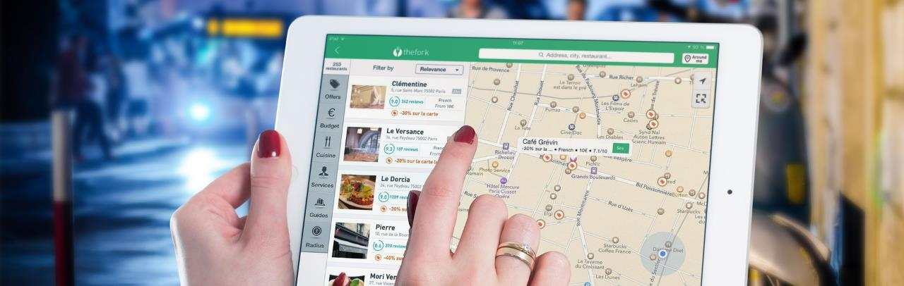






CONTACT US
Greenford,
London
ketanpansheriya1991@gmail.com
ketanpansheriya@eoll.co.uk
+44 7824076651
+44 7498540498
@Facebook
@Twitter
@Instagram

Slide 10

Thank You!
Notes:
Links:
https://www.pexels.com/photo/graphs-job-laptop-papers-590016/

